Slide 1
CONDUCT OF TRANSACTION/ DELIVERY & RECEIPT OF FUNDS:
CONSUMER VERSION

Slide 2
CONDUCT OF TRANSACTION BY ELECTRONIC MEANS

Slide 3

Can the buyer and seller enter into a contract on Form 2-T using electronic means?
Yes. The NC Uniform Electronic Transactions Act (“UETA”) is the law permitting transactions to be conducted by electronic means. In accordance with UETA, paragraph 20 of Form 2-T specifically provides that any action may be conducted electronically, including signing of the contract and any notice or communication given in connection with the contract.

Slide 4

When is notice given electronically considered to be complete?
Paragraph 20 provides that delivery of notice via electronic means is deemed complete when the person sending the notice performs the final act to send the notice in a form capable of being processed by the recipient’s system, and the notice is sent to any electronic address for the party listed in the Notice Information section.
EXAMPLE: A buyer agent emails a copy of a signed Form 350-T to the listing agent at 5:00 PM according to the buyer agent’s email program. According to the listing agent’s email program, the buyer agent’s email is received by the listing agent at 5:01 PM. The notice of termination would be deemed delivered at 5:00 PM.

Slide 5
DELIVERY/ACKNOWLEDGMENT OF RECEIPT OF FUNDS

Slide 6

Does delivery of the Due Diligence Fee to the listing agent constitute delivery to the seller?
Yes. Paragraph 20 of Form 2-T specifically states that any fee, deposit or other payment to be delivered to a party may be given to the party or the party’s agent.

Slide 7

When is delivery of the Due Diligence Fee or Earnest Money Deposit considered to be complete?
Delivery of the Due Diligence Fee to the seller or Earnest Money Deposit to the Escrow Agent is considered to be complete when the DDF or EMD has been placed into the actual possession or control of the seller or listing agent in case of the DDF, or the Escrow Agent in the case of the EMD.
Putting a DDF check in the US Mail or other courier service would not constitute delivery. The “mailbox rule” operates only as a method of communicating acceptance of an offer.

Slide 8
SIGNATURES

Slide 9
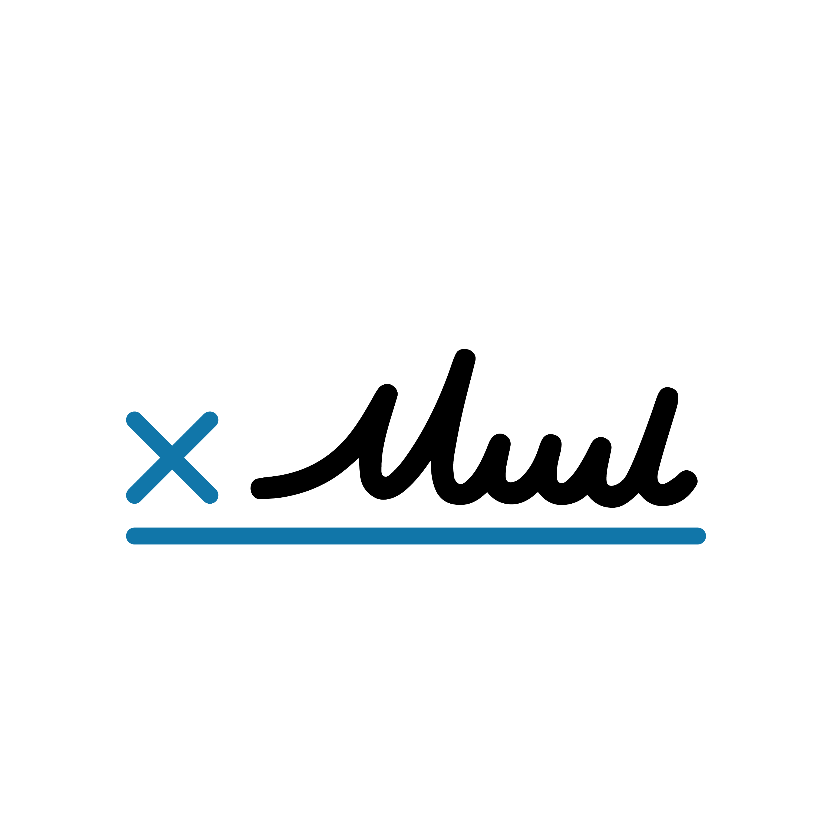
Who must sign the contract?
All persons listed as a “Seller” or a “Buyer” in paragraph 1 of Form 2-T must sign the contract. See article on Identification of Parties/Property for more information on who must be identified in a contract as a seller or buyer and the proper form of signature for persons acting in a representative capacity.

