Slide 1
DUE DILIGENCE PERIOD
CONSUMER VERSION

Slide 2

What is the Due Diligence Period?
It is an agreed-upon period of time during which the buyer can investigate the property and the transaction contemplated by the contract, terminate the contract for any reason or no reason, and receive a refund of any earnest money deposit.

Slide 3
How long should the Due Diligence Period be?
The length of the Due Diligence Period is entirely negotiable between the buyer and seller. There is no “standard” Due Diligence Period.
The Due Diligence Period should be of sufficient length to permit buyer:
to conduct any desired inspections/investigations of the property during the Due Diligence Period.
to complete any negotiations for repairs/improvements in which the seller may be willing to engage.
to pursue qualification for any loan the buyer may obtain, taking in to account the time needed for an appraisal to be completed and for the lender to provide sufficient information for the buyer to decide whether to proceed with or terminate the contract.
to be reasonably satisfied that closing on any other property the buyer needs to sell in order to qualify for a new loan or to otherwise complete the purchase of the seller’s property will take place prior to the Settlement Date of the Contract with the seller.
The length of the Due Diligence Period is also influenced by the amount of the Due Diligence Fee.

Slide 4

What types of investigation of the property should the buyer do during the Due Diligence Period?
Paragraph 4(b) of Form 2-T lists examples of things the buyer should consider investigating during the Due Diligence Period.
Although a real estate agent is generally not qualified to discover defects or evaluate the physical condition of property, a buyer’s agent can assist the buyer in finding qualified inspectors, appraisers and other professionals, and can provide the buyer with documents and other resources containing information about a prospective property.

Slide 5

Who is responsible for the costs of investigating the property?
The buyer is responsible for all costs associated with pursuing qualification for any loan and the costs of any desired tests, appraisals, investigations, examinations, and inspections that buyer deems appropriate, including costs of inspecting any repairs/improvements that the seller may agree to make.

Slide 6

May the buyer ask the seller to make any repairs/improvements?
Yes. The buyer may request that the seller make repairs or improvements, but the seller is not required to do so.

Slide 7
Can the seller limit the buyer’s investigation of the property?
Generally, no. The seller must provide reasonable access to the property through Closing.
The buyer’s access rights include allowing the buyer and the buyer’s agents or representatives the opportunity: (i) to conduct Due Diligence; (ii) to verify the satisfactory completion of negotiated repairs/improvements; and (iii) to conduct a final walk-through.
Some inspection activities might be considered unreasonably invasive (removing flooring or sheetrock walls, digging large holes, etc.) and should be conducted only with the seller’s consent.
Following the end of the Due Diligence Period the buyer’s right to terminate the contract as a result of the buyer’s investigation of the property is limited.

Slide 8
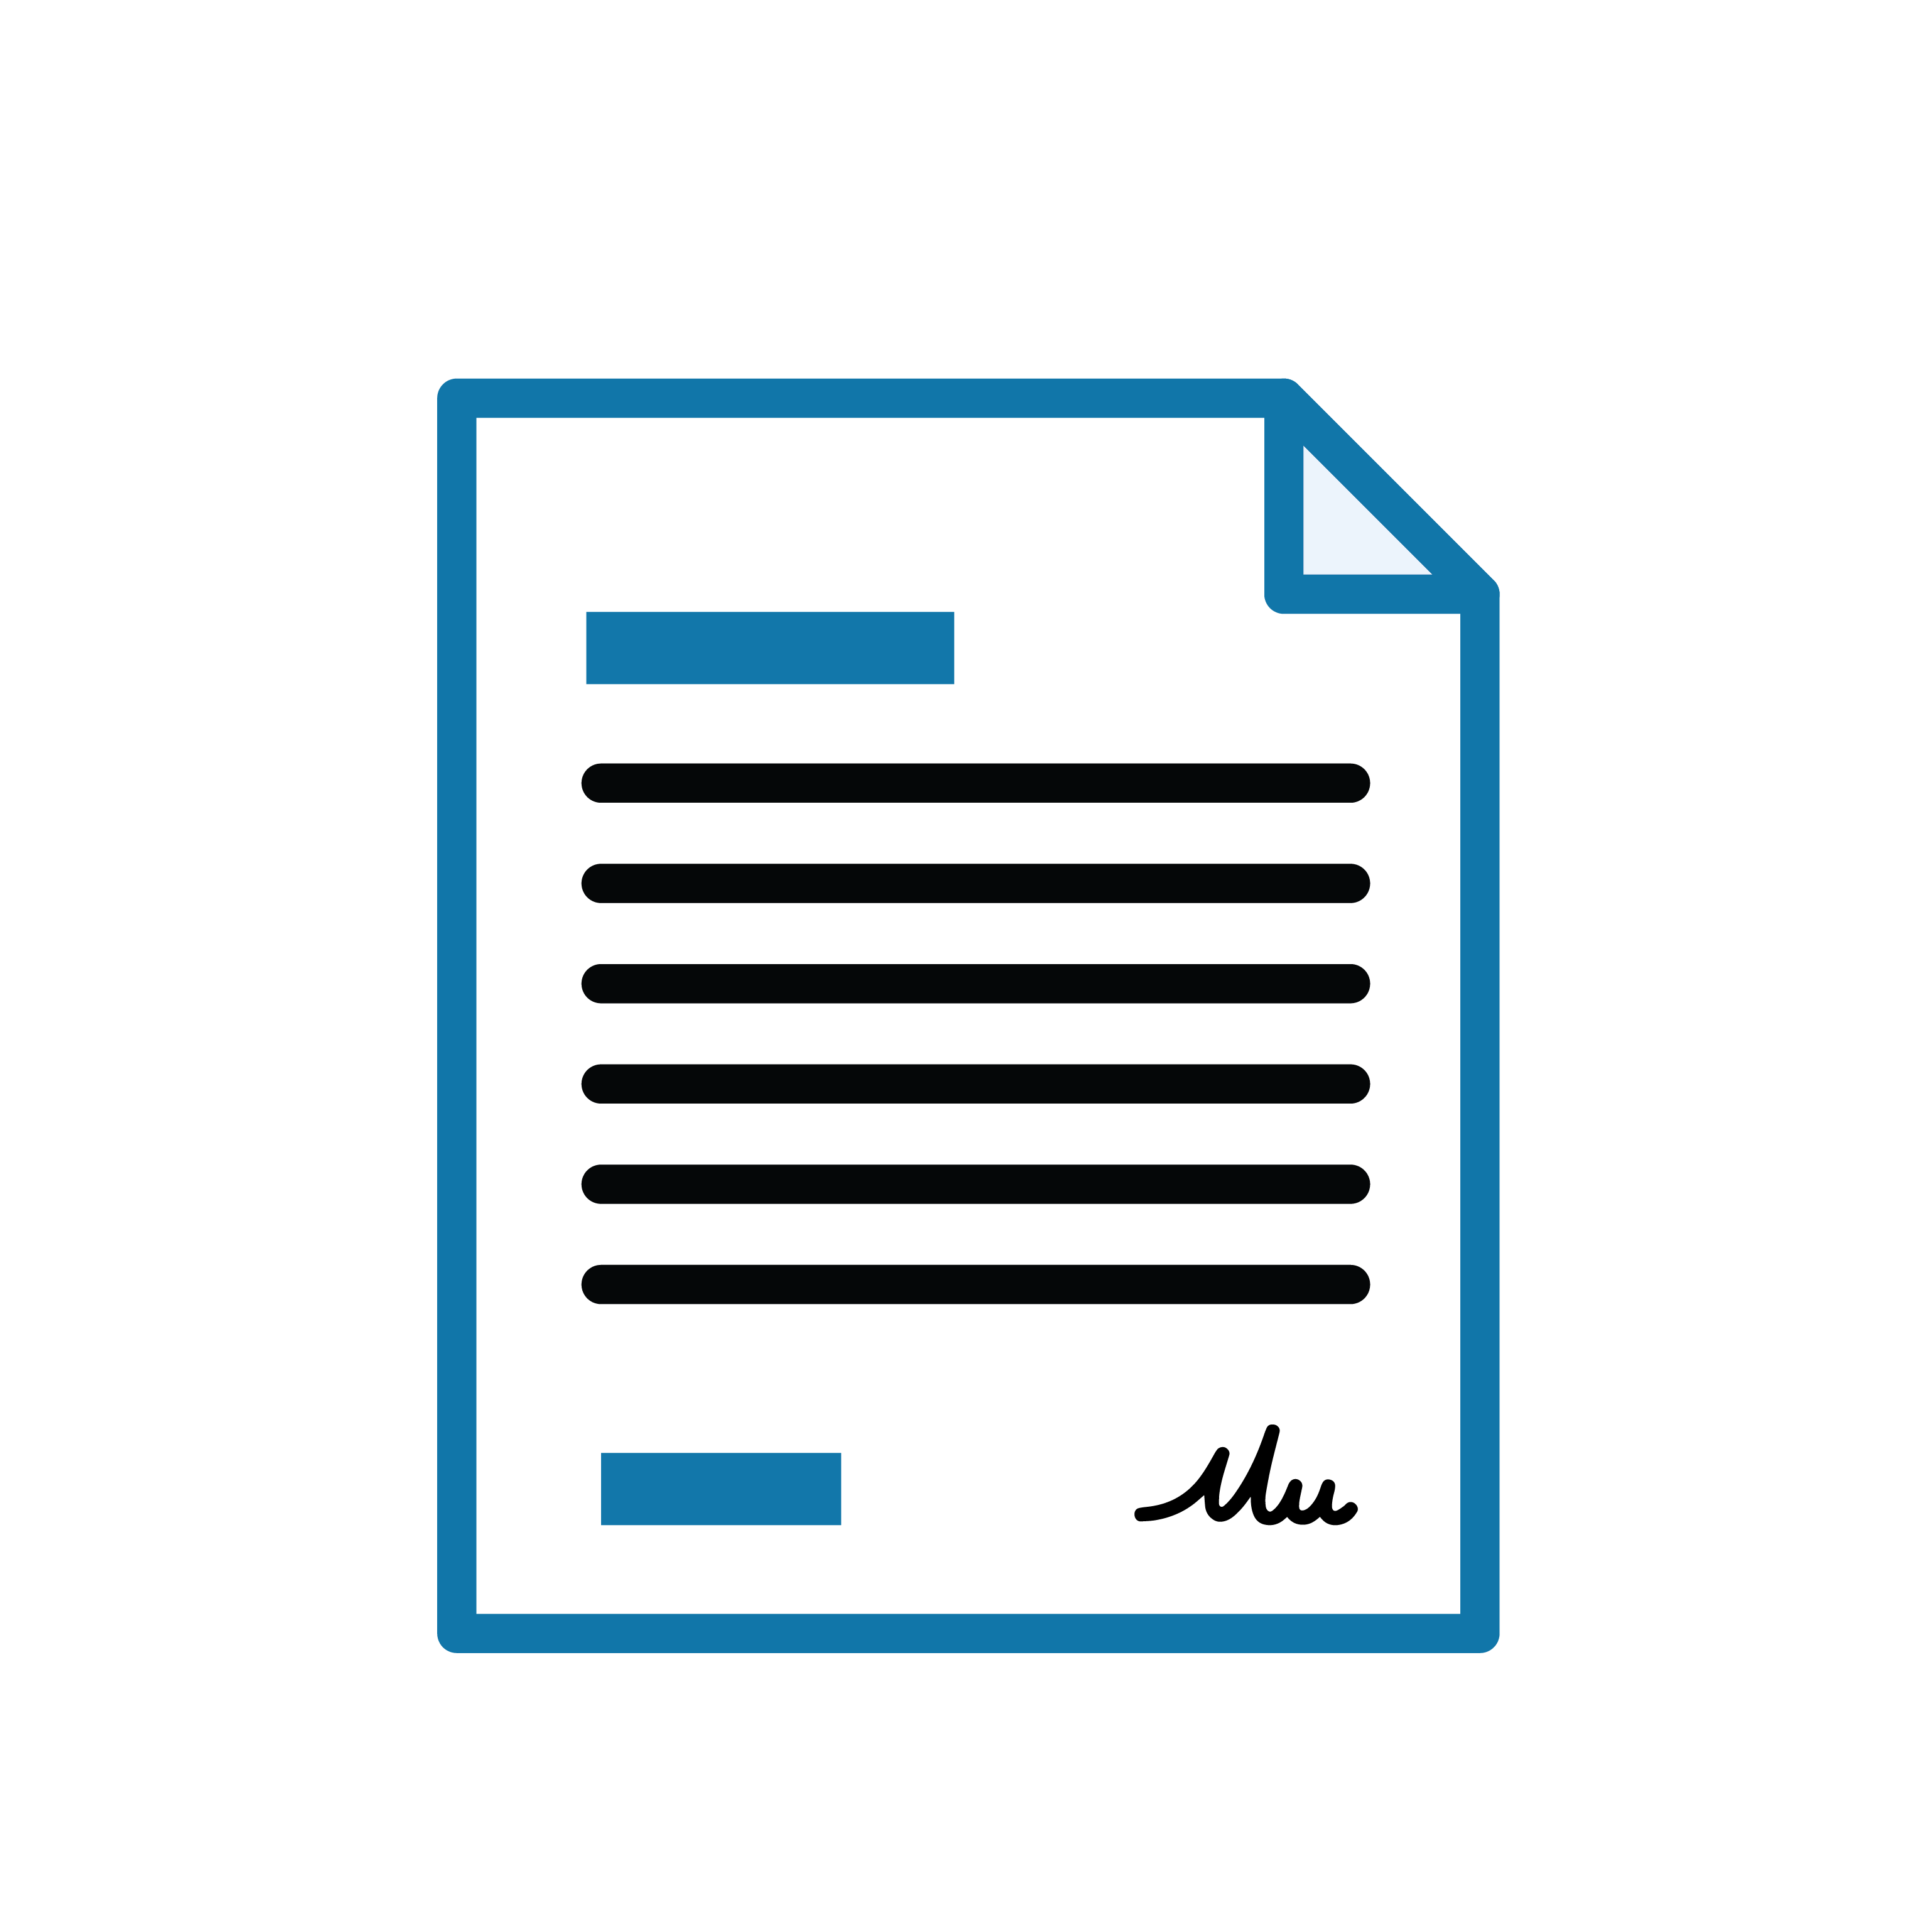
What if the buyer is not satisfied with the results of their investigation?
If the buyer is not satisfied with the results of the buyer’s Due Diligence or the progress of repair/improvement negotiations, the buyer is strongly advised, before the end of the Due Diligence Period, to enter into a written agreement with the seller to extend the Due Diligence Period or terminate the contract.
The seller is under no obligation to extend the Due Diligence Period.

