Slide 1
State of Real Estate
Tourism Recovery – 09.14.2021

Slide 2
Delta Variant has Recently Changed the COVID Situation
Date | 1/11/21 | 3/11/21 | 4/13/21 | 6/24/21 | 8/2/21 | 9/8/21
U.S. 7-day Avg. | 253,377 | 53,504 | 69,179 | 12,063 | 84,389 | 136,558
NC 7-day Avg. | 8,975 | 1,556 | 1,940 | 361 | 2,386 | 3,997
January
February
March
April
May
June
July
August
September
Source: CDC, 7-day Moving Average New Daily Cases

Slide 3
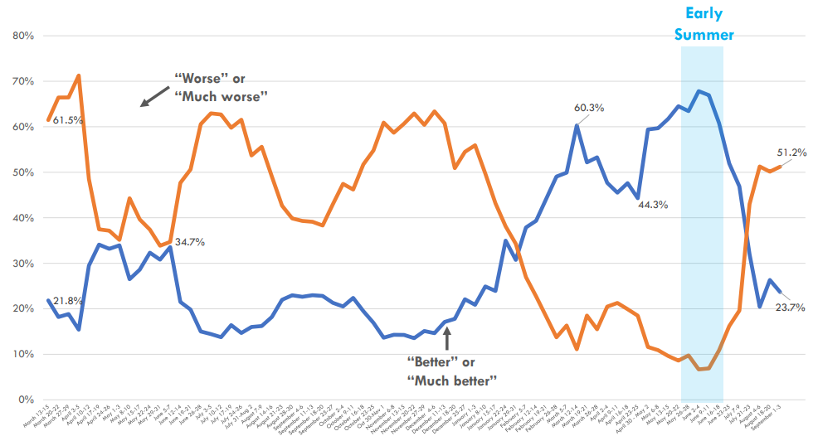
Travel Sentiment has Tracked Closely with COVID Cases
Question:
In the next month, how do you expect the severity of the coronavirus situation in the U.S. to change?
In the next month the coronavirus situation will be ________________
Source: Destination Analysts, Weekly Coronavirus Travel Sentiment Index Report, Sept. 7, 2021

Slide 4
23K Industry Jobs Added in 2021, Down 9% From ‘19
2019 Monthly Avg. = 147.3
90% of Lost Jobs Regained
4th Largest Industry
Representing 1 in 9 Jobs
in thousands
60K Jobs Lost
Source: U.S. Bureau of Labor Statistics, Charlotte MSA, Leisure & Hospitality Industry

Slide 5
Auto Travel Led Early Recovery, CLT Ahead of U.S. Avg.
2019 Levels = 100
2020
2021
Source: TSA, Checkpoint Travel Numbers, Charlotte Douglas International Airport, Monthly Activity Summary, Arrivalist, Daily Travel Index

Slide 6
F&B Spending has Surpassed Pre-pandemic Levels
Daily Table Reservations
% Change From Same Time 2019
Monthly F&B Spending
Indexed to 2019
Source: Open Table, Mecklenburg County Tax Office

Slide 7
Hotel Room Demand has Closed Within Nearly 10% of ’19 Level
2019 Hotel Room Demand = 100
Source: STR, Mecklenburg County, Rolling 28-day Demand, Indexed to Same 28-day Period in 2019

Slide 8
Hotel Recovery Led by Weekend Leisure Demand
Source: STR, Mecklenburg County, Day of Week Demand Average

Slide 9
Perceptions of Safety Vary Widely Across Travel Spectrum
Question:
At this moment, how safe would you feel doing each type of travel activity?
________________
% Safe or Very Safe
Source: Destination Analysts, Weekly Coronavirus Travel Sentiment Index Report, Sept. 7, 2021

Slide 10
Urban Destinations Lag Resort/Rural in Recovery
Source: STR, U.S. Monthly Hotel Review, July 2021, Percent (%) Change from 2019

Slide 11
While Hotels Suffered, Short-term Rentals Thrived
Source: STR, Hotel Performance Indexed to 2019, AirDNA, Short-term Rental Performance Indexed to 2019
*2019 Performance = 100

