Slide 1
Market Outlook
Week of June 8 to 12
Lawrence Yun
Chief Economist
National Association of REALTORS®

Slide 2
GDP Details in 2020 Q1
2020 Q1 or April | % change annualized rate
GDP | -5.0%
Consumer Spending | -7%
Business Spending | -8%
Residential Investment (Home building, home sales, remodeling) | +18%
Personal Income in April | +12%
Savings Rate in April | 33% (from 8% a year ago)

Slide 3
20.5 M jobs lost in April 2020

Slide 4
Total Payroll Jobs in the U.S.; 2.5 million job creations in May

Slide 5
Total Payroll Jobs in North Carolina in April

Slide 6
New Cases of Unemployment Relief in NC

Slide 7
Total Cases of Unemployment Relief in NC

Slide 8
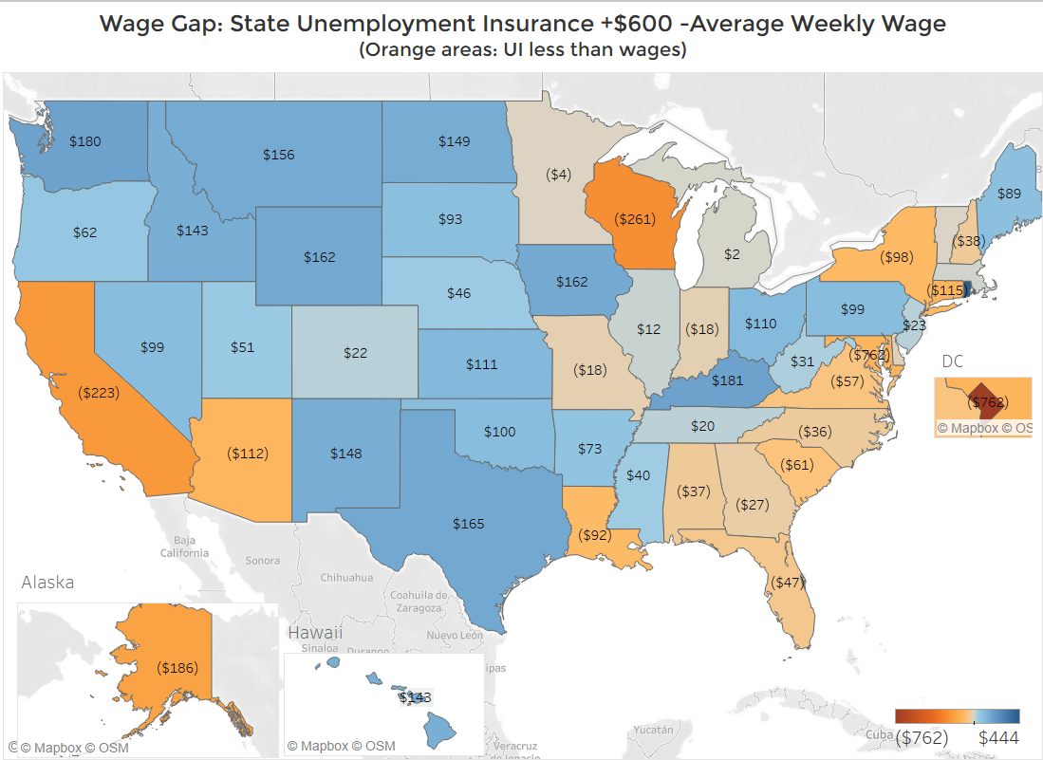
Unemployment insurance benefits don’t fully replace wages in some states

Slide 9
Federal Reserve All-In
Quantitative Easing including buying Corporate Debts

Slide 10
30-Year Mortgage Rate can fall Further …
Because of Super-low 10-year Treasury Yields …
But Jumbo Loans not Working

Slide 11
Inventory
Low Pre-Pandemic … Lower During Pandemic

Slide 12
Pending Contracts … March and April Pandemic Impact …
Improve in May … Even Better in Later Months

Slide 13
Early Phase of Home Buying Process
Mortgage Application to Buy a Home … Worst is Over?

Slide 14
Housing Shortage …
Falling Below Normal Again during Pandemic

Slide 15
Federal Budget Deficit … $4 trillion in 2020 … Who will buy U.S. debt?

Slide 16
OUTLOOK 2020-2021

Slide 17
2020 Quarterly Forecast
 | Annualized Rate | Year over year change
2018 | 5.34 million
2019 | 5.34 million
2020 Q1 actual | 5.48 million | +5%
2020 Q2 | 3.8 million | -28%
2020 Q3 | 4.7 million | -13%
2020 Q4 | 5.1 million | -6%

Slide 18
Annual Forecast
 | 2019 | 2020 Forecast | 2021 Forecast
GDP Growth | 2.3% | -4.5% | +3%
Job Gains | 2.2 million | - 4 million | + 2 million
Home Prices | 4.8% | 3% to 5% | 1% to 3%
Home Sales | 0% | -10% to -13% | +13 to +18%

Slide 19
Permanent Changes after Pandemic
Virtual Office Meetings
More Remote Working
Less Traffic near City Centers
Move Further Out
Larger House

