Slide 1
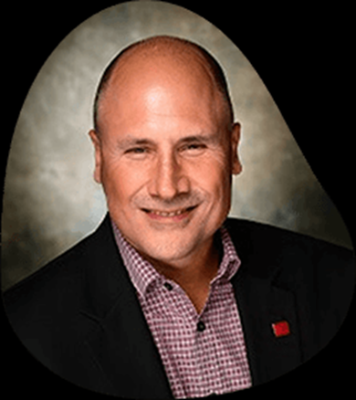
NC COMMERCIAL REAL ESTATE OVERVIEW & opportunities
Pete Frandano, CCIM
Current Board of Director: Charlotte Regional Commercial Board of REALTORS
Humble and grateful: Past President, North Carolina CCIM Chapter; Past President Brunswick County Association of REALTORS; Past Wilmington Commercial Board Member; Past Regional VP, NCR, Coach and current ongoing very proud Dad…
Practices commercial brokerage and commercial appraisal
Author, Endurance Real Estate
Product of our great state: Proudly has lived in Charlotte (current primary), Chapel Hill, Winston Salem (Son #1 Born here), Greensboro (Son #2 Born here), Boone, Southport…Bounced all over the Globe but…
NO PLACE LIKE HOME!

Slide 2
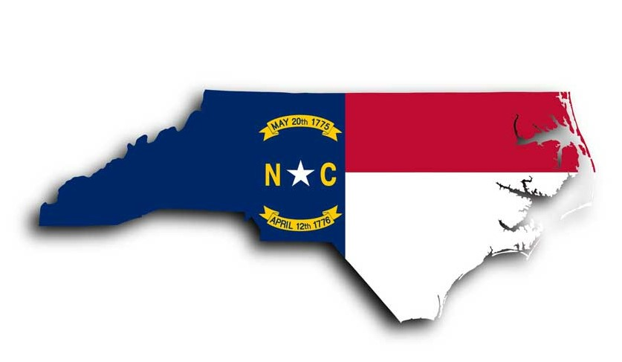
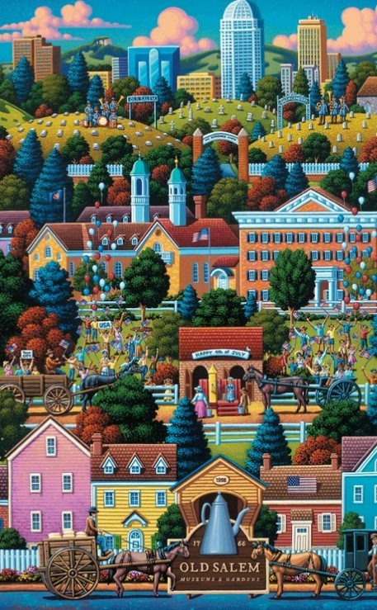
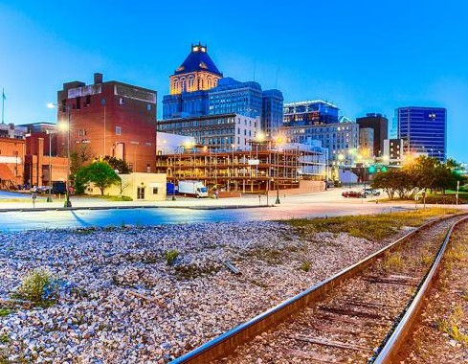
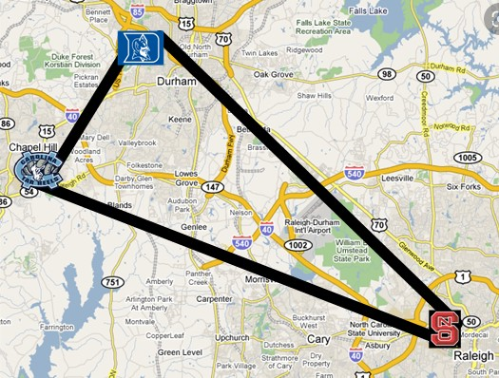
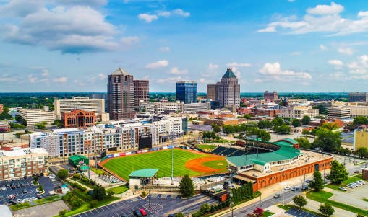
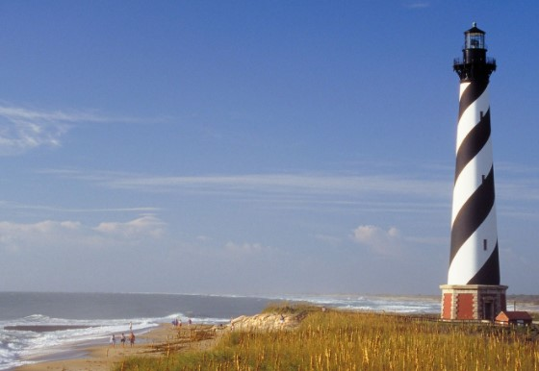
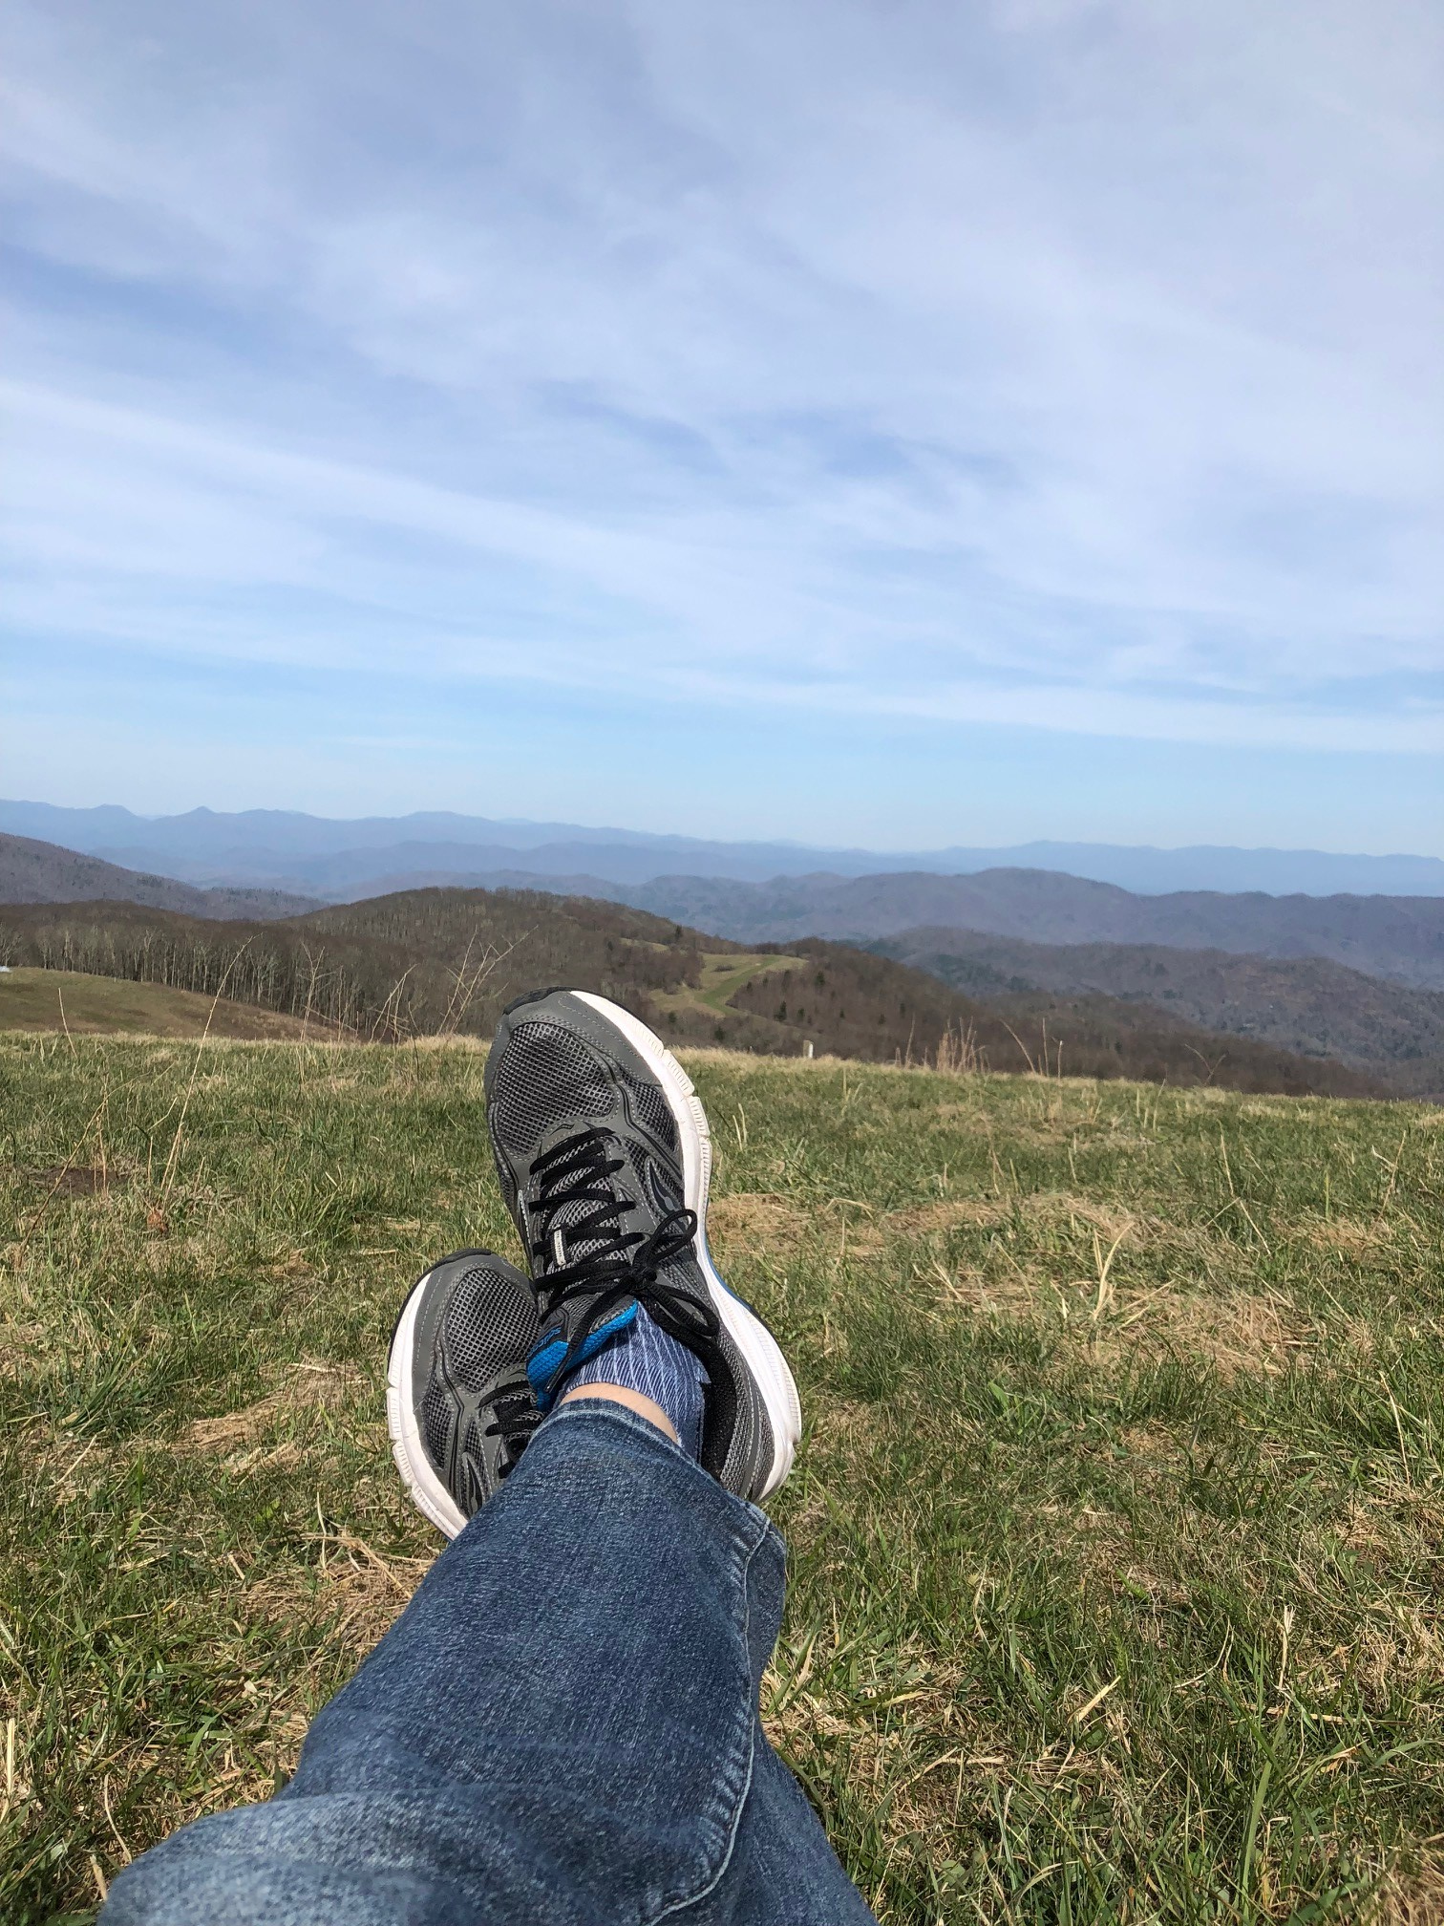
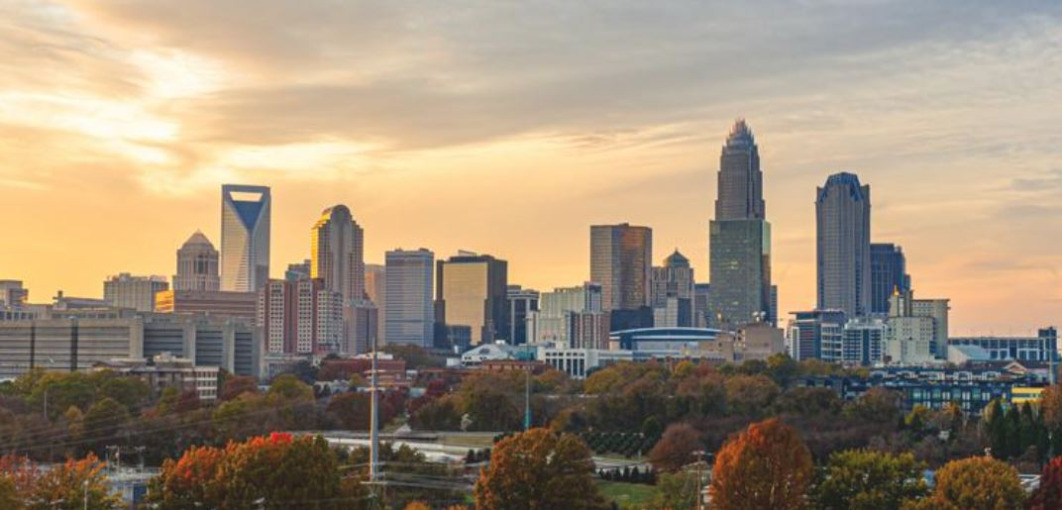
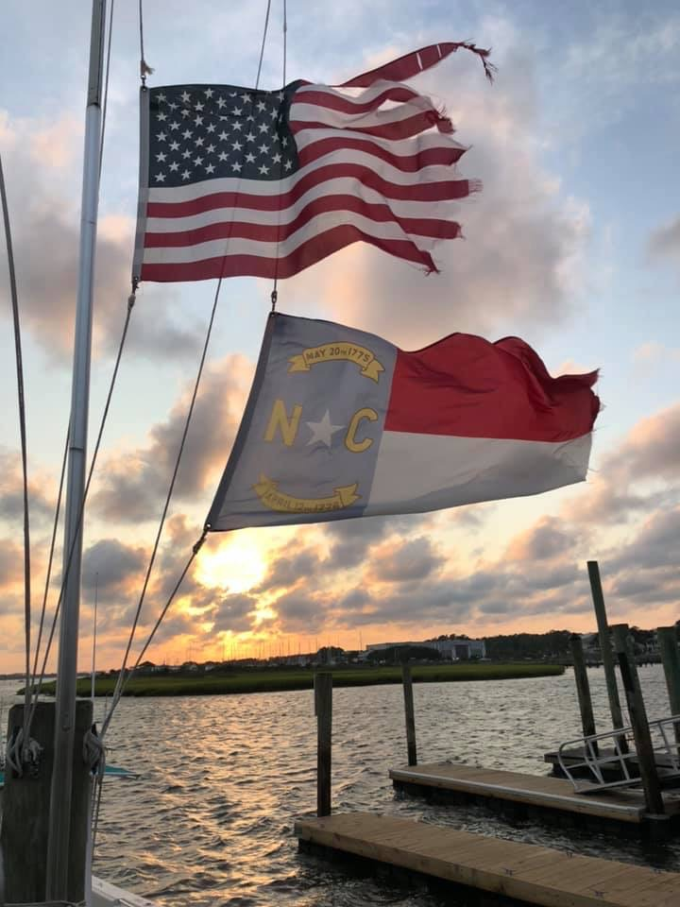
35,000 FOOT VIEW and a “mantra”
FROM THE MOUNTAINS TO THE SEA, WE HAVE ONE OF THE BEST PIECES OF LAND IN THE COUNTRY IN OUR GREAT STATE!

Slide 3
NORTH CAROLINA right up at the top
#1
Top States for Business Climate
Site Selection Mag, 2020
10.5 Million People
Steady Talent Pipeline
Low Cost of Living
Amazing Quality of Life
Logistics Hub: 170+ Million customers in a day’s drive
Consistently in the Top 5 in Net Domestic Migration

Slide 4
A Report from the field, Commander: What we are seeing coming out of the Pandemic
SUPER CHARGED SECTORS: RESIDENTIAL, MULTI-FAMILY, INDUSTRIAL…
SECTORS TRYING TO FIGURE OUT WHO THEY WANT TO BE: RETAIL, OFFICE
SECTORS POSITIONING FOR SURVIVAL THEN REVIVAL: HOSPITALITY > HOTEL, RESTAURANTS, MOVIE THEATERS
DENSITY IN NC? WE DON’T KNOW DENSITY! AND THAT APPEARS TO BE A MAJOR PLUS IN THE POST COVID WORLD…
MANY OWNERS/INVESTORS TRYING TO FIGURE OUT WHAT THEY HAVE AND WHAT ITS WORTH – SOME REPOSITIONING OF ASSETS OCCURING e.g. RETAIL TO LAST MILE DISTRIBUTION, (SOME) HOTELS TO MULTI-FAMILY?
WHAT’S ALL THIS MEAN? >>>
OPPORTUNITIES FOR THE VIGILANT!

Slide 5
a few abbreviated field reports – from ccim’s across our great state

Slide 6
Western nc james milner, CCIM & Jason burk, CCIM James: Appalachian Commercial Real Estate, LLC; james@appalachiancre.com; 828/719-0408 Jason: whitney commercial real estate services; jburk@whitneycre.com; 828/674-2120
Continue to see supply and demand issues which are impacting pricing – e.g. no supply/high demand
Industrial/Warehouse high rents, very low inventory and strong investment demand
Zero drive through sites available that are priced within a reasonable range
Sellers concerned about tax issues > rise in capital gains
Supply of housing and workforce housing major concern
Lack of labor is hurting most sectors but really hampering hospitality industry

Slide 7
Triad – tim lichtentstein, ccim Linville | Team Partners Commercial Real Estate tim@ltpcommercial.com ; 336/423-8292
Multi-family demand remains strong – lack of existing investment inventory and costs of NEW construction continues to place upward pressure on pricing and rents
All markets considered, secondary and tertiary as well as investors seek yield.
Industrial demand for investment, owner occupant and “for lease” product extremely strong
Retail > destination retail gaining momentum; new “mom and pop” retail is scarce
Office – worst performing sector as rent concessions offer little support
Downtown Metros (CBD) slow to come back post covid (Editors note: we see a common theme across the state and our fruited plain…)

Slide 8
Triangle – jay taylor, CCIM & Beverly keith, ccim crx JAY: SVN Tar Heel Commercial Realty, Inc. jay.taylor@svn.com ; 919/233-8077 BEVERLY: RED SHOE ECONOMICS; beverly@redshoeeconomics.com; 919/896-4431
Industrial Market very strong with vacancy hovering around 3% - Amazon driving most of the growth
Multi-family market strong – 95% occupancy with strong rent growth
Office: hit harder than other segments – Rent growth has slowed > “pandemic driven shadow space” with rise of Delta – most projections are for sublet space to be absorbed 12-18 months with full recovery in 2022.
Retail > Mixed story > essential businesses thrived (grocery anchored) while non core properties have struggled.

Slide 9
charlotte – your presenter
Industrial Market – lot of folks at every level diving for this football – the ring has pushed out from the core of Charlotte
Multi-family market strong –
Office: Struggling – CBD Trying to figure out “what’s next and how to handle”
Retail > Mixed story > essential businesses thrived (grocery anchored) while non core properties have struggled.
Very low residential land tract inventory within the Metro

Slide 10
Wilmington market - pj Doherty, ccim & patrick riley, ccim PJ: Carolina commercial investment properties, llc; pjdoherty@atmc.net; 910/297-9572 patrick: Cape fear commercial; patrick@capefearcommercial.com; 910/264-2153
Restaurant and hospitality sectors are being pummeled with unemployment also hampering these areas
Core retail (like Mayfaire and Landfall in Wilmington) doing every well (Note: Mayfaire is an open air, Big box anchored destination retail venue)
Big money chasing yields has created an unhealthy flurry of investment activity
Land price increases combined with material cost increases are making new development challenging and hard to pencil
Covid has had detrimental impact on timing for permits and site approvals – many munis operating on skeleton staff in planning and zoning depts (Editors note: common theme)
Proposed tax policies have investors nervous

Slide 11
SUMMARY
NOTHING COULD BE FINER…THAN TO BE IN CAROLINA > OUR FUNDAMENTALS (BONES) ARE GREAT!
MOST COMMERCIAL REAL ESTATE FOLKS KNOW THAT HOUSING IS THE ENGINE THAT POWERS THE TRAIN: WE NEED MORE INVENTORY IN HOUSING MARKET– UNHEALTHY LOW INVENTORY (CAN I GET A “DUH”?)
MOST OF US DON’T SEE NET IN-MIGRATION STOPPING IN THE NEAR, MID OR LONG TERM
THREATS? POLITICAL, FISCAL, MONETARY POLICIES?
THE ‘WHAT WE DON’T KNOW’ FACTOR
OPPORTUNITIES FOR THE VIGILANT…

Slide 12
Some Lessons Learned Along my Journey
A few suggested action items…(AKA: things I remind myself!)
FOCUS ON CIRCLE OF CONTROL AND INFLUENCE
REMEMBER WE ARE ALL ENDURANCE ATHLETES: IN BUSINESS, LIFE, ALL OF IT!
VALLEYS AND UPHILLS WILL COME > TFRA (CHOICES: HOW DO WE TREAT, FACE, REACT, ATTACK THEM?)
RUN YOUR OWN RACE > WHAT IS YOUR RACE? YOUR REGION’S RACE? WHO CAN YOU HELP RUN THEIR RACE? OPPORTUNITIES?
ITS A MARATHON AND A SPRINT: BUT THE MARATHON: PLEASE RECOGNIZE WHEN YOU’RE RUNNING ONE, >>> PROPER PACE = CROSSED FINISH LINES!

Slide 13
Thank you!

