Slide 1



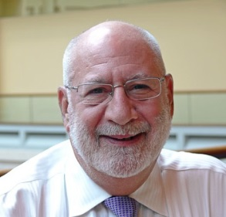
Effective Association Leadership in Remarkable Times
A Conversation with
Glenn Tecker
Chairman & CO-CEO
Tecker International, LLC
January 14th, 2021
9:00 AM – 3:30 PM

Slide 2
Copyright@2020 by Tecker International, LLC
- All Rights Reserved -
These materials were specially prepared for instructional use by Tecker International, LLC. No portion of these materials, in whole or in part, may be used in any fashion, or reproduced by any means, without the written permission of Tecker International, LLC.
For more information and valuable links to other
sources of information and insight, please visit
www.tecker.com
Tecker International, LLC
301 Oxford Valley Road, Suite 1504 B, Yardley, PA 19064
215-493-8120
info@tecker.com

Slide 3
Program Overview
I. Understanding the Organization
Perspectives Of Leadership
Challenges for Associations Today
Future Assumptions and Key Drivers
II. Leading Together
Thinking & Working Style Preferences
III. Leading the Organization
Roles & Responsibilities
Representative Governance Model
Association Infrastructure
IV. Leading the Board
Effective Decisions
Board Agenda
Effective Engagement
V. Critical Issues for Today’s Leaders
Distinguishing Value Proposition(s)
Navigating Today’s Critical Issues
Leading Change

Slide 4

Discussion Thread I
Understanding the Organization
Perspectives of Leadership
Challenges for Associations Today
Future Assumptions and Key Drivers

Slide 5
Why People Behave the Way They Do
What is perceived is.
Perceptions are based on available information.
In the absence of information, we assume.
Behavior, no matter how crazy, has a logical basis.

Slide 6

An Association
A group of people who voluntarily come together to solve common problems, meet common needs, and accomplish common goals.

Slide 7
An Association’s DNA
What makes associations unique is that the same populations are:
  the owners,
  the customers and
  the workforce of the organization.

Slide 8
Associations Today
Maintaining focus on mission
Providing hope and future vision
Reassessing priorities
Responding to racial injustice
Redesigning delivery models and customer experiences
Investing reserves and changing financial models
Balancing reinvention with maintaining what is known
Others?

Slide 9

Vision & Value Based Strategy
Balancing the aspirational and the actionable
Pursuing a compelling vision of the future while providing relevant value today consistent with that vision

Slide 10
Associations Need To…
Navigate future scenario uncertainties while they mitigate immediate challenges and build a better future
Adapted from “Five Priorities to Help Reopen and Reinvent Your Business, Accenture, May 2020
https://accntu.re/2CiTYr8
What if, then what?

Slide 11
Identifying Key Drivers
Change in current condition
Result of Change
Dynamic causing tomorrow to be different than today
Trend
Future Assumption
Key Driver

Slide 12
Discussion Prompt
Create list of future assumptions (there will be…).
From your assumptions, identify the key drivers influencing the future of your members’ industry/profession/cause.
Identify impact of drivers on members and/or others that you serve.
Discuss how the association could respond (consider opportunities and challenges).
Identify actions to be taken.
Follow-up questions:
How do we create a continuous flow of information regarding our members’ environment?
How do we ensure the right balance between gathering and using information?

Slide 13

Industry/Profession/Cause Future Assumptions and Key Drivers
Future Assumptions
Considerations: Technology, workforce, social values, industry/profession structure, economics, legislation and regulations
_______________________________
_______________________________
_______________________________
_______________________________
_______________________________
________________________________
________________________________
________________________________
Key Drivers
________________
________________
________________
_________________
_________________

Slide 14
Impact of Key Drivers
 | Impact on Members and/or Other customers |  | Association Response
Key Drivers | Immediate | Longer-term | Immediate | Longer-Term

Slide 15

Priorities
Put members and staff first – place caring at the core
Redesign programs and spaces – ensure a safe, inclusive, and engaging environment
Solve in phases – redesign for business as unusual
Commit to an elastic operational structure – create short-term efficiencies and fuel for growth
Get future-ready – continue to plan for the future and get “next-gen” ready
Adapted from “Five Priorities to Help Reopen and Reinvent Your Business”, Accenture, May 2020
https://accntu.re/2W57RAe

Slide 16

Discussion Thread II
Leading Together
Thinking & Working Style Preferences

Slide 17
Understanding One Another’s
Thinking & Working Style Preferences
Four key dimensions of leader work and related preferences in associations:
Communicating/problem-solving (E-I)
Planning (S-N)
Decision-making and conflict resolution (T-F)
Day-to-day working relationship (P-J)
MY MBTI TYPE ___ ___ ___ ___
What’s your animal personality type according to Buzzfeed?
http://bit.ly/4timbti
https://www.16personalities.com

Slide 18
The Leadership Partnership - Preferences
Challenges we face today require an immediate consultative partnership from the CSE and CEO. There is no more “grace period” for the partners to get to know how one another will operate as a leader.
Directions:
Read the description of the first preference dimension.
Decide which description is most like your preference.
Share your finding and the reasons for it with your partner(s).
Then answer the following question:
When we are [fill in the role] it would help me if you would: __________________________________.
5. Then read the next description of the next preference and repeat the process.

Slide 19

Extrovert & Introvert Preferences
E&I: The Leadership Dimension of Communicating and Problem Solving
The E and I preferences indicate where a person gets their energy and zest for life. An Extrovert is stimulated by the outside environment — by people, places, and things. Introverts, on the other hand, are simulated from within — from their own inner world of thoughts and reflections. Extroverts are energized by what is going on around them (cocktail parties prove this) and do their best work externally by acting. They prefer to communicate openly and freely. Introverts, are energized by their own personal experiences (not other’s experiences) and inner resources, and they do their best work internally by providing reflection and deep thought before acting. They prefer not to communicate openly and freely until they know and trust someone. (Ever try to stimulate group interaction with a group of Introverts who do not know one another?).
Extroverts tend to focus on broad implications and Introverts focus on more single subjects in-depth — both are required for effective problem solving and can be effectively utilized if the partners understand their differences.
Partners with the same preference may lack either the breadth or in-depth perspective in their analysis, which presents a different challenge. How do they achieve balance in their problem solving?
Extroverts tend to think, and problem solve out loud. You know that they are problem solving because you can see their lips moving and hear them thinking. Extroverts often say, “Just let me talk long enough and I will figure out the answer.”
Introverts usually problem solve differently. They require a short period of quiet reflection time to think about and reflect on the problem before they can discuss it. Introverts typically say, if I can just get some quiet time to hear myself think, I can figure out the answer.
A significant challenge occurs when you mix E’s and I’s together in problem solving. E’s immediately start talking out loud and the I’s cannot hear themselves think (just like radar or communication jamming). The result of this situation is that the I’s will not interact in the problem solving at all.
Two E’s (is anyone listening?) or two I’s (is anyone talking?) also have their challenges when communicating and problem solving.
Adaptation by Bud Crouch
based upon The Myers Briggs Type Indicator®

Slide 20
Sensing & iNtuiting Preferences
S&N: The Leadership Dimension of Planning
The Sensing and iNtuiting functions are ways that we prefer to perceive and take in information. The Sensing function takes in information by way of the five senses and likes to look at specific parts and pieces of that information, deal with known facts and live in the present enjoying what exists.
The iNtuiting function also takes in information via the five senses, but then adds a sixth sense — a gut hunch or intuitive feeling. Most N’s will state, I make my worst decisions when I go against my intuitive hunch. N’s are very conceptual and prefer to look at overall patterns and relationships. They like to deal with broad concepts or possibilities, and they plan in the future. They enjoy anticipating what might be.
As a result of the broad preferences, S’s and N’s tend to approach planning differently. N’s prefer the broad, overall conceptual look, like to work with possibilities in the future and are comfortable with visioning processes. N’s like to define where the organization is going and the possible attributes, conditions, outcomes that it may seek to obtain.
S’s, on the other hand, prefer step-by-step pragmatic planning that is based upon what can feasibly be accomplished today. They are most comfortable in developing strategies, steps and action plans to achieve certain goals. They prefer to define how the organization is going to achieve its goals.
If N’s conceived of putting man on the moon, the S’s devised the systems and hardware to make it happen.
Obviously, a good plan requires both perspectives — long range conceptual goals (where) and pragmatic strategies and actions plans (how). It is important to understand which strengths and preferences each partner brings to the planning process.
For partners of the same preference, the challenge is that they may not focus on one of the two critical planning components — either the where or the how.
Adaptation by Bud Crouch
based upon The Myers Briggs Type Indicator®

Slide 21
Thinking & Feeling Preferences
T&F: The Leadership Dimension of Decision-Making and Conflict Resolution
The Thinking and Feeling functions are ways that we prefer to decide and evaluate. The Thinking preference decides based on logic and objective considerations (in their head, not in their heart). T’s prefer to decide things on an impersonal basis. They keep their personal feelings at a distance from the issues that are being decided. They tend not to let their emotions become involved in the decision-making process, and they highly value the notion, reasonableness and competence in any decision-making. It is not that T’s do not have feelings — just that they do not get their feelings involved in the decision-making process.
Feeling types also make decisions objectively in their head, but they then add a subjective component of deciding in their hearts based on issues of personal and subjective values.
F’s tend to decide things based on what they like or don’t like, their values, and the impact of the proposed decision on people (they have strong values on how people should be properly and fairly treated). As a result, F’s tend to literally place themselves inside the situations. They tend to put themselves in others’ shoes and are sensitive to how they may feel. Their feelings become involved in the decision-making process.
Because of these different preferences, T’s and F’s approach and handle conflict differently. T’s like to get disagreements out into the open. T’s tend to enjoy a good argument (discussion), and to argue points based on what they perceive as reason without involving much emotion. As a result, they can walk away from a good argument or confrontation and think no more about it.
F’s generally do not like conflict and tend to avoid it. Because they often get their personal feelings involved, conflict has more of an emotional impact on them. They often worry about how they could have handled the situation differently (better). They tend to think and mull over what went on during the process.
The one area where F’s will enter conflict is when they think that people have been mistreated or unjustly wronged. In this situation, F’s can often carry a grudge, especially where their strong values concerning people have been perceived to be violated. T’s should know, there is nothing more dangerous than a wounded F. They originated the phrase “I don’t get mad, but I do get even.”
Adaptation by Bud Crouch
based upon The Myers Briggs Type Indicator®

Slide 22
Judging & Perceiving Preferences
J&P: The Leadership Dimension of Day-to-Day Working Relationships
Judging and Perceiving are ways that we prefer to interact with our environment — both personal and at work. While all the style differences present the potential for preference conflict, it is the difference in how J’s and P’s approach their environment that can result in the greatest day-to-day style working differences and potential conflicts.
J’s like a lifestyle that is decisive, planned and orderly. They have a very strong desire and need to come to closure (sometimes too quickly). They work best in an environment when they can plan and follow what they plan. J’s are the list makers of the world. They love to do lists and what makes them most happy is to be able to check things off the “to do” list. They are very punctual — usually early.
P’s are exactly the opposite. They prefer a life and working style that is flexible, adaptable and spontaneous. They enjoy being curious and discovering surprise. For P’s, the journey is more important than the destination (the opposite of J’s). They like to maintain openness and will not answer a closed-ended question (the best answer you can get is — maybe).
J’s typically schedule fun on their calendar. For P’s, work must be fun. P’s tell time differently than J’s — most J’s believe that P’s do not tell time at all. P’s originated the phrase, it isn’t over until its over — and even then, it may not be over. They are very innovative, like to make last minute changes, and to finish things in a with a last-minute rush — all of which drives J’s crazy. They enjoy new and innovative projects, may not be the best finishers, and can be the best crisis management people in the organization. P’s bring a special newness and fun to organizations. They are quick to challenge the J’s notion, that things have always been done this way.
Partners who have the same style, share the challenge of possibly missing the balancing perspective of the other’s preference. Partners who have different styles, but do not find value in the preference differences are in for a LONG YEAR!
Adaptation by Bud Crouch
based upon The Myers Briggs Type Indicator®

Slide 23
Working Preferences
Where do you and your partner(s) have different or similar leadership styles and behavior?
How can you cooperatively turn these differences and similarities into an advantage for your partnership?
What might you have to watch out for?

Slide 24

Discussion Thread III
Leading the Organization
Roles & Responsibilities
Representative Governance Model
Trust

Slide 25
Leading Together for Good Governance
Structure
Process
Culture

Slide 26

Board Responsibilities
Set organization’s direction
Ensure necessary resources
Provide oversight

Slide 27

Set Organization’s Direction
Engage in strategic thinking
and planning
Set the organization’s mission and vision for the future
Establish organizational values
Ensuring alignment of operational or annual plans with the strategic plan

Slide 28


Ensure Necessary Resources
Hire capable executive leadership
Ensure adequate financial resources
Promote positive public image
Ensure the presence of a capable and responsible Board

Slide 29

Provide Oversight
Oversee financial management
Minimize exposure to risk
Measure progress on strategic plan
Monitor programs and services
Provide legal and moral oversight
Evaluate the CSE & Board

Slide 30


Oversight
Outcomes
Board
Supervision
Activity
Senior Staff

Slide 31

Board Fiduciary Responsibilities
Duty of Care
Duty of Obedience
Duty of Loyalty

Slide 32
Duty of Care
Be informed and ask questions.
The duty of care describes the level of competence that is expected of a board member and is commonly expressed as the “duty of care that an ordinary prudent person would exercise in a like position and under similar circumstances.”
This means that a board member owes the duty to exercise reasonable care when he or she decides as a steward of the organization.

Slide 33
Duty of Obedience
Requires board members to be faithful to the organization’s mission.
They are not permitted to act in a way that is inconsistent with the central goals of the organization.
A basis for this rule lies in the public trust that the organization will manage donated funds to fulfill the organization’s mission.

Slide 34
Duty of Loyalty
Show undivided allegiance to the organization’s welfare.
A standard of faithfulness; a board member must give undivided allegiance when making decisions affecting the organization.
A board member can never use information obtained as a member for personal gain and must act in the best interest of the organization.
Board members must comply with policies regarding code of conduct and ethical behavior.

Slide 35
Principles of Good Governance Process
High Level Self-Assessment
Key: 1=all the time; 2=most of the time; 3=seldom; 4=never
  Our governing bodies define and delegate rather than react and ratify.
  Our leadership focuses on the outcomes desired rather than on the activity required.
  Our leadership focuses on what needs to happen next, rather than on what has already been done.
  Our discussions are informed, rather than opinion rich and information poor.
  Our leaders spend their valuable and limited time together using information not collecting it.
  Issues of capacity, core capability, strategic position and all possible choices are routinely considered in deciding what to do.
  Fiduciary responsibility is exercised by defining desired outcomes consistent with strategic intent and core values, rather then detailing how an outcome is to be achieved or re-managing work after it has been accomplished.

Slide 36
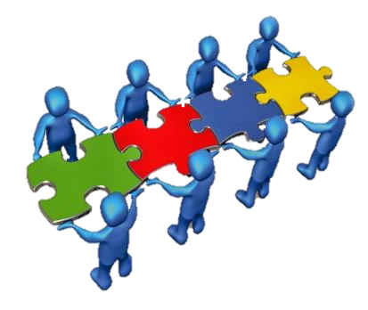
The Representative Governance Model
One part political
One part corporate
Two parts weird

Slide 37
Representative Governance Model
Whose interests do you represent?
The component that sent you?
or
The association as an enterprise?

Slide 38

Representative Governance Model
The answer – in practice – in the political/corporate hybrid is probably:

Slide 39
Transparency & Trust in Governance
Occurs when board members understand the difference between being
“representative for”
versus being
“representative of.”

Slide 40
Representative For
If board members believe they are “representative for,” they see themselves as the elected representatives of a particular constituency.
They voice only the self interests and opinions of that constituency and vote only on behalf of that constituency’s interests.

Slide 41
Representative Of
Board members who view their role as ensuring that the views, beliefs, values, and self interests of the constituencies they know the best are on the table as part of the conversation, are “representative of.”
They voice interests and opinions of those they know best and vote on behalf of the best overall interests of the organization.

Slide 42
Model of Association Infrastructure
CULTURE
Key Processes
Research, Data & Analytics
Strategy
Policy
Resource Allocation
Key Structures
Membership
Governance
Program
Workforce
Financial
6. Technology

Slide 43
Organizing and Aligning
An organization’s structure results in better performance only if it improves the organization’s ability to make and execute key decisions better and faster.
If an organization can sync its structure with its decisions, then the structure will work better, and performance will improve.
Adapted from, “The Decision-Driven Organization,” HBR, June 2010

Slide 44

What Needs Attention?
1= Strongly Disagree 2=Disagree 3=Agree 4=Strongly Agree
___ Our structure helps-rather than hinders-the decisions most critical to our success.
___ Individuals understand their roles and accountability in our most critical decisions
___ Our processes are designed to produce effective, timely decisions and action.
___ The people in critical decision roles have the information they need when and how they need it.
___ Our measures and incentives focus people on making and executing effective decisions.

Slide 45
What Needs Attention?
1= Strongly Disagree 2=Disagree 3=Agree 4=Strongly Agree
___ People understand their priorities clearly enough to be able to make and execute the decisions they face?
___ We make decisions in a style that is effective (for example, that appropriately balances inclusiveness with momentum).
___ We put our best people in the jobs where they can have the biggest decision impact.
___ Our leaders at all levels consistently demonstrate effective decision behaviors.
___ Our culture reinforces prompt, effective decisions and action throughout the organization.

Slide 46
Discussion Prompt
What part of our organization’s infrastructure needs attention right now?
What might need attention in the next six months? Next year?

Slide 47

Discussion Thread IV
Leading the Board
Effective Decisions
Balanced Board
Board Agenda
Effective Engagement
Assessing Performance

Slide 48
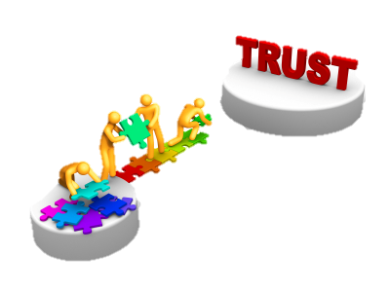
Trust in Decisions
Members will respect governance they perceive to be:
Credible
and
Legitimate

Slide 49

Decision Making
Performance ultimately is the sum of the strategic decisions you make and execute.

Slide 50
Rate Your Decision Effectiveness
4 = Most of the time 3 = Some of the time 2 = Infrequently 1 = Never
QUALITY When looking back on critical decisions, we find that we chose the right course of action.
Cite examples of when the organization chose wisely.
2. SPEED We make critical decisions with sufficient pace.
Have opportunities been lost as a result of slow decision-making?
3. YIELD We execute critical decisions as intended.
Are measures of success and/or “check-in” points established in advance of implementation?
EFFORT In making and executing critical decisions, we put in the right amount of effort.
Do we consider the resources required for success and impact on other initiatives, projects, programs or service?

Slide 51
Flaws in Decision Making
(Adapted from “Hidden Flaws in Strategy” by Charles Roxburgh, 2003)
Not like us
Overconfidence – the tendency to want to do more than is possible.
“Mental Accounting” – the tendency to misunderstand how the sources of revenue relate to how money is spent.
Status Quo Bias – the tendency to want to leave things as they are.
Anchoring – the tendency to choose what is familiar.
Sunk-Cost Effect – the tendency to keep investing in bad strategies/activities.
Herding Instinct – the tendency to conform to the behavior and opinion of others.
False Consensus – the tendency to overestimate group consensus and desire to agree with others.
Like us

Slide 52

The Strategic Board Agenda
Critical Issue Discussion – Immediate and/or Longer Term
Review and Adjustment of Strategy
Policy:
Public & Operational
Routine Board Business

Slide 53
A Board Role “Continuum”
Strategy and Policy: All board work is focused on the strategic, long-term direction of the organization, including external scanning, goal and strategy development, policy development, and overall evaluation and accountability.
Strategy, Policy, and Management: Most board work is focused on strategy and policy, but also includes some high-level management functions.
Management: Most of the the board's work is comprised of managing the operations of the organization, including planning, organizing, directing, supervising, and evaluating operations.
Management and Operations: The board spends most of its time managing the operations of the organization, but also serves as the actual workforce for certain administrative or programmatic operations.
Operations and Activities: The majority of the board's work is comprised of doing the frontline operational work of the organization, because board members also are the organization's volunteers.

Slide 54

Delegation by the Board
Rule 1: Only Do What Only You Can Do
Rule 2: Be Clear About Expected Outcomes
Rule 3: Understand How You Will Monitor Progress Without Meddling

Slide 55


A Role “Continuum” for the CSE
Indentured
Servitude
Religious - like Deity
administrator
technical expert
strategist
manager
visionary
clerk
facilitator
planner
advisor

Slide 56
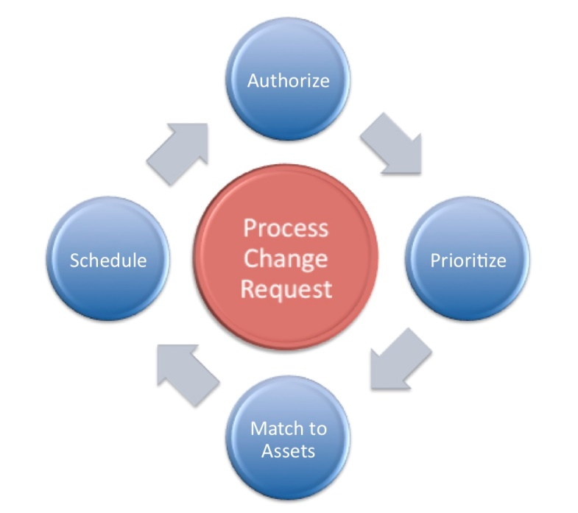
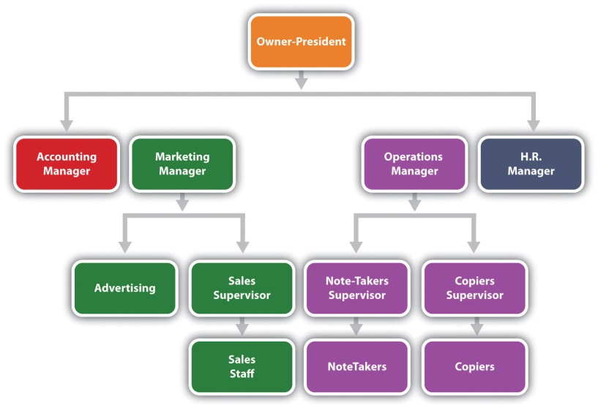
Associations As A Collaborative Network Rather Than A Traditional Hierarchy
In Associations most significant decisions are made by a process rather than by a person or position…

Slide 57

Discussion Thread V
Critical Issues for Today’s Leaders
Distinguishing Value Proposition(s)
Navigating Today’s Critical Issues
Leading Change

Slide 58
The Distinguishing Value Proposition(s) of An Association
Commitment:
Consistent and organized focus on important things of high value that require coherent effort over time.
TRUST
TRUST
Our “Brand”
Member’s Actual Experience
Content:
Advocacy- effective clout that influences the beliefs and behaviors of others that affect things that are significant to me; Knowledge – insight that enables me to be successful at things that really matter to me.
Community: Enjoyable shared experience that makes me feel better about myself and my place in the world.
TRUST

Slide 59
Our Distinguishing Value Proposition(s)
What Will Constitute Success?
Commitment:
____________________________________________________________________________________________
Content:
____________________________________________________________________________________________
Community:
____________________________________________________________________________________________

Slide 60
What is a “Critical Issue?”
…an overarching issue of strategic importance that has significant short-term and long-term implications
Failing to address it could compromise the organization’s mission
An issue with significant implications for both members and the association.
Requires both deep AND expedient conversation to take action
Best considered in short and longer- term planning horizons

Slide 61

Navigating Today’s Critical Issues
How do we develop realistic strategic responses - “If this? Then what?”
How do we respond intelligently and thoughtfully to current conditions and critical unknowns using potential scenarios in a way that is realistic and consistent with the association’s mission and envisioned future?

Slide 62
Critical Issues Prioritization Matrix
THIRD IN LINE
High Urgency
Low Impact
“Urgent” but not impactful
TOP PRIORITY
High Impact
High Urgency
Start here!
High
URGENCY
Low
NEXT IN LINE
High Impact
Less Urgency
Identify and assess options
THESE CAN WAIT
Low Impact
Low Urgency
Delay, Delegate or Delete
Low IMPACT High
Process note: After this point, it is most effective to work on each issue separately

Slide 63
Discussion Prompt
Which of your Key Drivers identified earlier are high priority?
How do these issues fit into your overall strategic board agenda?

Slide 64
So…
What will we do differently as a result of the conversations over the last two days?
What will we direct/assist others to do differently as a result of these conversations?

Slide 65

Resistance to Change
What will it be like?
Increase comfort
Create a vision
Support
Unknown
Neutrality
Change Resistance Anxiety Fear
Opposition
Unknown
Will I be able to handle it?
Increase self esteem
Demonstrate confidence in
their competence

Slide 66
Nature of Change and Transition
Change
Transition
An event
  Either anticipated or unanticipated
  Either chosen or imposed from somewhere else
Change is external
A personal reaction
  How we alter behavior and perspective to come to terms with the change
Transition is internal

Slide 67
The Transition Process*
Endings → Chaos → New Beginnings
(Stop) (Wait) (Start)
The starting point for transition is not the change.
ENDINGS are required to leave the old behind.
*William Bridges, Managing Transitions: Making the Most of Change

Slide 68

APPENDICES
LEVELS OF /ENGAGEMENT MATRIX
BOARD SELF EVALAUTION

Slide 69
BOARD/SENIOR STAFF OPTIMAL LEVELS OF ENGAGEMENT
FUNCTIONAL AREA | Chief Staff Executive |  | Chief Elected Officer |  | Board
 | Current | Desired | Current | Desired | Current | Desired | Current | Desired | Current | Desired
Direction Setting
Strategic Direction/Vision
Strategic Plan
Strategy Implementation
Resources
Financial Strategy
Investment Strategy/Portfolio Management
Budget
Financial Reporting
Audit
Ethical Performance and Compliance
Volunteer Leadership Development
Culture
1 - makes the decision; approves and authorizes action
2 - Involved in discussing the choices as the decision is being made but does not have a vote
3 - opinions are solicited before the discussion takes place and considered in the discussion
4 - informed of the decision and the reasoning behind it after the decision is made
5 - not involved

Slide 70
BOARD/SENIOR STAFF OPTIMAL LEVELS OF ENGAGEMENT
FUNCTIONAL AREA | Chief Staff Executive |  | Chief Elected Officer |  | Board
 | Current | Desired | Current | Desired | Current | Desired | Current | Desired | Current | Desired
Oversight
CSE Performance Appraisal
CSE Compensation
CSE Succession
Board Effectiveness
Board Assessment
Board Selection
Staff Structure
Other
Brand Positioning
Government Affairs Policies
Stakeholder Relations
New Product Development
Member Recruitment and Retention
Program Operations
Sponsorships
Other
1 - makes the decision; approves and authorizes action
2 - Involved in discussing the choices as the decision is being made but does not have a vote
3 - opinions are solicited before the discussion takes place and considered in the discussion
4 - informed of the decision and the reasoning behind it after the decision is made
5 - not involved

Slide 71
Board Self Evaluation
The association leadership experience is a group experience and a group responsibility. This group experience is most successful when expectations are clearly defined and agreed to by all parties. One way a board can promote clarity of purpose is by engaging in self-evaluation.
The purpose of this survey is to focus on key responsibilities, relationships, and outcomes – and to foster an environment of organizational excellence. Only a commitment on the part of board and staff members to strengthen the capacity for group excellence can overcome the complex challenges facing many associations today.
Please take a few moments to read the following statements. How accurately do they describe your board? Answer on a scale of one to six, with one being “not at all like us” and six being “very much like us.”

Slide 72
Oversight and Direction Setting
Very much Not at all like us like us |  |  |  |  |  | Attribute
6 | 5 | 4 | 3 | 2 | 1 | We participate in board meetings where most of the agenda and board time is focused on issues of direction setting, policy and strategy.
6 | 5 | 4 | 3 | 2 | 1 | We maintain sound fiscal policy and practices and realistically face the financial ability of the organization to support its program of work.
6 | 5 | 4 | 3 | 2 | 1 | We are committed to strategically planning for the long-term future of the organization, consider this a regular activity of the board, and weigh all decisions in terms of what is best for those served by the organization.
6 | 5 | 4 | 3 | 2 | 1 | We work to foster growth in the organization based on the ability to understand how the decision(s) interrelate with other Boards, committees, and external organizations.
6 | 5 | 4 | 3 | 2 | 1 | We take into consideration the immediate and long-term issues and ramifications associated with the decisions and actions that are taken.

Slide 73
Relationship with Chief Staff Executive
Very much Not at all like us like us |  |  |  |  |  | Attribute
6 | 5 | 4 | 3 | 2 | 1 | We have clarified (in writing, if appropriate) a mutually agreed upon definition of what success will look like for the organization and for the performance of the CSE, and we have provided the resources and authority necessary to achieve expectations.
6 | 5 | 4 | 3 | 2 | 1 | We have provided the CSE with a clear statement of the personal qualities and performance expectations against which he/she will be measured periodically; and we have agreed to a formative process for providing feedback as plans are being executed.
6 | 5 | 4 | 3 | 2 | 1 | We provide opportunities, encouragement and resources for the professional growth and development of the CSE and staff.
6 | 5 | 4 | 3 | 2 | 1 | We discuss immediately, rather than allow to fester or deteriorate, those items that are controversial to either board members or the CSE.

Slide 74
Board Meetings and Relationships
Very much Not at all like us like us |  |  |  |  |  | Attribute
6 | 5 | 4 | 3 | 2 | 1 | We honor the established procedures for board meetings, providing ample time for interested parties to be heard, but preventing a single individual or group from dominating discussions.
6 | 5 | 4 | 3 | 2 | 1 | We seek ways to support all elected leaders and fellow board members in the successful execution of leadership duties. We seek to recognize the strengths of each individual and provide opportunities for the organization to benefit from these strengths.
6 | 5 | 4 | 3 | 2 | 1 | We make informed decisions based on data available and support the organization’s commitment to collecting the information needed for sound decision making.
6 | 5 | 4 | 3 | 2 | 1 | We seek and respect the opinion or recommendation of staff management when considering a decision and ensure that board committees and other work groups are given proper authority and resources for completion of assignments.
6 | 5 | 4 | 3 | 2 | 1 | We do not redo the work of committees or work groups.
6 | 5 | 4 | 3 | 2 | 1 | We take the appropriate time for decision making (e.g., controversial items are given adequate attention, and matters of urgency are acted on with deliberate speed) and present decisions of the board without bias to others.

Slide 75
Stakeholder Relationships
Very much Not at all like us like us |  |  |  |  |  | Attribute
6 | 5 | 4 | 3 | 2 | 1 | We actively foster a clear understanding of the organization, its future direction, and its leadership decisions among the stakeholders, and actively foster open lines of two-way communication and information sharing between leadership and the stakeholders.
6 | 5 | 4 | 3 | 2 | 1 | We seek to be fully informed of stakeholder attitudes and the special interest groups seeking to influence the organization and are fully prepared to represent the interests of the organization to others.
6 | 5 | 4 | 3 | 2 | 1 | We act responsibly in channeling concerns, complaints, and criticisms of the organization through the CSE, and we speak thoughtfully in the face of unjust criticism of others.

Slide 76
Personal Qualities
Very much Not at all like us like us |  |  |  |  |  | Attribute
6 | 5 | 4 | 3 | 2 | 1 | We demonstrate an ability to think independently, grow in knowledge and rely on fact rather than prejudice, and are willing to hear, understand, and consider all sides of a controversial question.
6 | 5 | 4 | 3 | 2 | 1 | We show respect for the intentions and interests of others and for group decisions cooperatively reached.
6 | 5 | 4 | 3 | 2 | 1 | We have a willingness to devote the necessary time to fulfilling the responsibilities of a board member as outlined in the organization's written position description.
6 | 5 | 4 | 3 | 2 | 1 | We are prepared to let go of our leadership roles and fully support (not interfere with) those who follow in future leadership.

Slide 77
Interpretation
Very much Not at all like us like us |  |  |  |  |  | Implication
xxxx | xxxx |  |  |  |  | Consensus: A strength to be recognized and nurtured
 |  |  |  | xxx | xxxx | Consensus: A weakness to be examined and corrected
x | xx | x | x | xx | x | Distributed response: A bad item / Different understandings / Different experiences as a member of the board. A response to be diagnosed and cause corrected.
xxxx |  |  |  |  | xxxx | Bifurcated response: Widely divergent understandings / A secondary, symbolic, or symptomatic item reflecting a values dispute. A response to be diagnosed and the root cause examined and resolved.
xxxx | xxx |  |  |  | x | An outlying response: Different understanding / different experience elsewhere. A response to be understood and considered for potential to improve process.
Note: Means, medians and modes can be useful but are usually insufficient*

Slide 78
Glenn Tecker
Glenn Tecker is Chairman and Co-CEO of Tecker International, LLC, a multinational consulting practice that has completed projects for over 2000 groups in the U.S., Europe, Canada, Asia, Scandinavia, Mexico, and Central America.
Glenn is widely acknowledged as one of the world’s foremost experts on leadership and strategy. Having worked in an executive capacity with businesses, public agencies, and non-profit organizations, he has also served as a board member for several non-profit and for-profit organizations. Glenn’s particular expertise in the areas of governance, program strategy, organizational design, research analysis and presentation skills will be critical to the effort. Some highlights of his accomplishments include:
Guiding National Collegiate Athletic Association [NCAA] member and staff leadership of the through a participative and transparent process that redefined the organization's core purpose and values, developed vision-based strategy and action plans, and realigned the NCAA's priorities to lead a re-focusing of the university athletic experience for the 21st Century.
Developing new organizational, program, and operational strategy with the United States Green Building Council [USGBC] to provide innovative solutions to global ecological concerns in order to successfully navigate a period of multiple opportunities, complex demands and rapid growth.
Designing and conducting an institute for an international philanthropic organization to train representatives from 10 Asian nations with a tradition of conflict.
Devising strategy and developing competencies with school districts, educational agencies, and school board and teacher associations working to improve teaching, learning, and organization.
Assisting the United States Environmental Protection Agency, the American Water Works Association, the Technical Institute of the Pulp and Paper Industry and other environmental advocacy organizations to foster global use of technologies that contribute to quality of life.
Facilitating planning activities of information, telecommunications and entertainment related organizations in high technology industries challenged by tough competition and constant dramatic change.
Supporting research and program planning efforts of agricultural organizations addressing complex issues related to food safety, industry prosperity, and shifts in the demography and economics of agriculture.
Glenn is also the co-author of three best-selling books – The Will to Govern Well: Knowledge, Trust and Nimbleness; Building a Knowledge-Based Culture: Using 21st Century Work and Decision-Making Systems in Associations; and Successful Association Leadership: Dimensions of 21st Century Competency for the CEO. He currently serves as vice chair of the Board of Guide Dogs for the Blind Foundation and America’s Vet Dogs in NY. He formerly served as Board Chair of New Hope Academy – a nonprofit multi-campus nontraditional alternative school in Pa. In 1998, Glenn was honored as the recipient of ASAE’s Academy of Leaders Award - the highest possible recognition awarded by ASAE’s Board of Directors to professionals making a lasting contribution to the field..

Slide 79
About Tecker International, LLC
For more than 30 years, Tecker International (LLC) has helped thousands of clients meet goals, impact lives and change the world. TI is a client-focused, mission-driven international consulting practice offering a broad range of services tailored to fit our clients’ unique needs. In partnership with our clients, we identify opportunities, overcome challenges and create structures and processes nimble enough to adapt to environments of rapid change. Our knowledge-based, outcomes-oriented approach has helped to transform associations, not-for-profit organizations, institutions and businesses of all kinds.
The collective competencies of the Tecker team enable us to provide the talent, skills and expertise to achieve the goals of each of our clients. Drawing on the firm’s knowledge base and experiential resources, we employ a friendly, collaborative approach to empower organizations to succeed. In additional to being expert strategists, skillful facilitators and subject-matter experts, Tecker consultants are also top-notch educators who are always willing to share fresh ideas and proven methods of success. When you engage with Tecker, you choose a team of friendly, responsive, respected professionals, with extensive knowledge of personal and organizational dynamics. Their passion and enthusiasm inspires and motivates leaders to act and tackle challenges head on.
TI specializes in managing change, strategic planning, governance remodeling, repositioning companies and programs, strategic alliances and consolidations, market and member research, executive coaching, parliamentary procedure and a variety of other disciplines. We offer in-depth subject matter knowledge of specific industries, businesses and professions. TI builds a sustaining culture of innovation to support an organization’s ability not only to survive but to thrive. Our clients return to us again and again because they experience the measurable, positive outcomes our knowledge-based strategic thinking and planning creates. We guide volunteer and staff leaders to lead with confidence and clarity.
With so many consultants to choose from, what factors set the Tecker team apart?
We are committed to superior thinking achieved by a team that is constantly learning and sharing through client engagements, original research, full community participation and by serving as faculty for the ASAE CEO Symposium.
We listen to our clients and their needs are our priority.
For each engagement, we build a shared vision of the future based on knowledge, not opinion.
We provide practical tools to achieve the shared vision of the future.
We ensure implementation by including all key stakeholders in building and supporting change.
We understand that there are no best practices, only good practices customized to the unique needs and cultures of each of our clients.
We develop successful volunteer/staff teams based on their unique roles and their importance to the success of the organization.
We help staff create plans for communication, action and evaluation to ensure successful follow through on decisions made.
We have a genuine love of what we do, and a deep appreciation of the value diverse perspectives bring to analytic and creative discussions.

