Slide 1
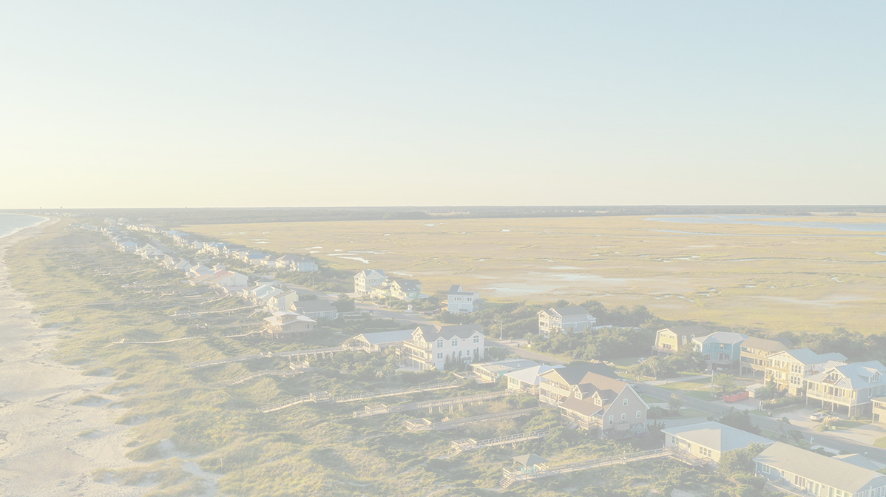
Affordability impediments:
-Tourism-based economy
-Investment-driven purchasing
-Land poverty
-Builder margins
-Restrictive covenants
-Wastewater capacity limitations
Regulatory impediments:
-Absence of local authority to control short-term rentals
-Absence of local authority to mandate affordable development
-Absence of effective affordable housing incentives
Population increase estimates/data:
-Year-round population doubled since last year
-Starts/permitting up
-Increasing displacement from affordable housing
Middle housing pros/cons:
-Must be visually compatible
-Must fit design standards
-ADUs mostly visually compatible
-ADUs may increase price
Local solutions implemented:
-ADUs
-Density bonuses

